Slide 1
A poem & prayerful reflection from APT Ireland (Act to Prevent Trafficking), based on the living legacy of St. Brigid (Brigid of Kildare), whose mother was trafficked and made to marry a chieftain. Brigid’s legacy is ever more relevant today as we strive to care for and empower all who have been trafficked and exploited.

Slide 2
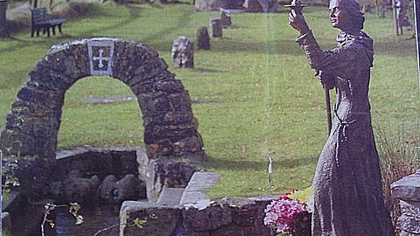

Slide 5
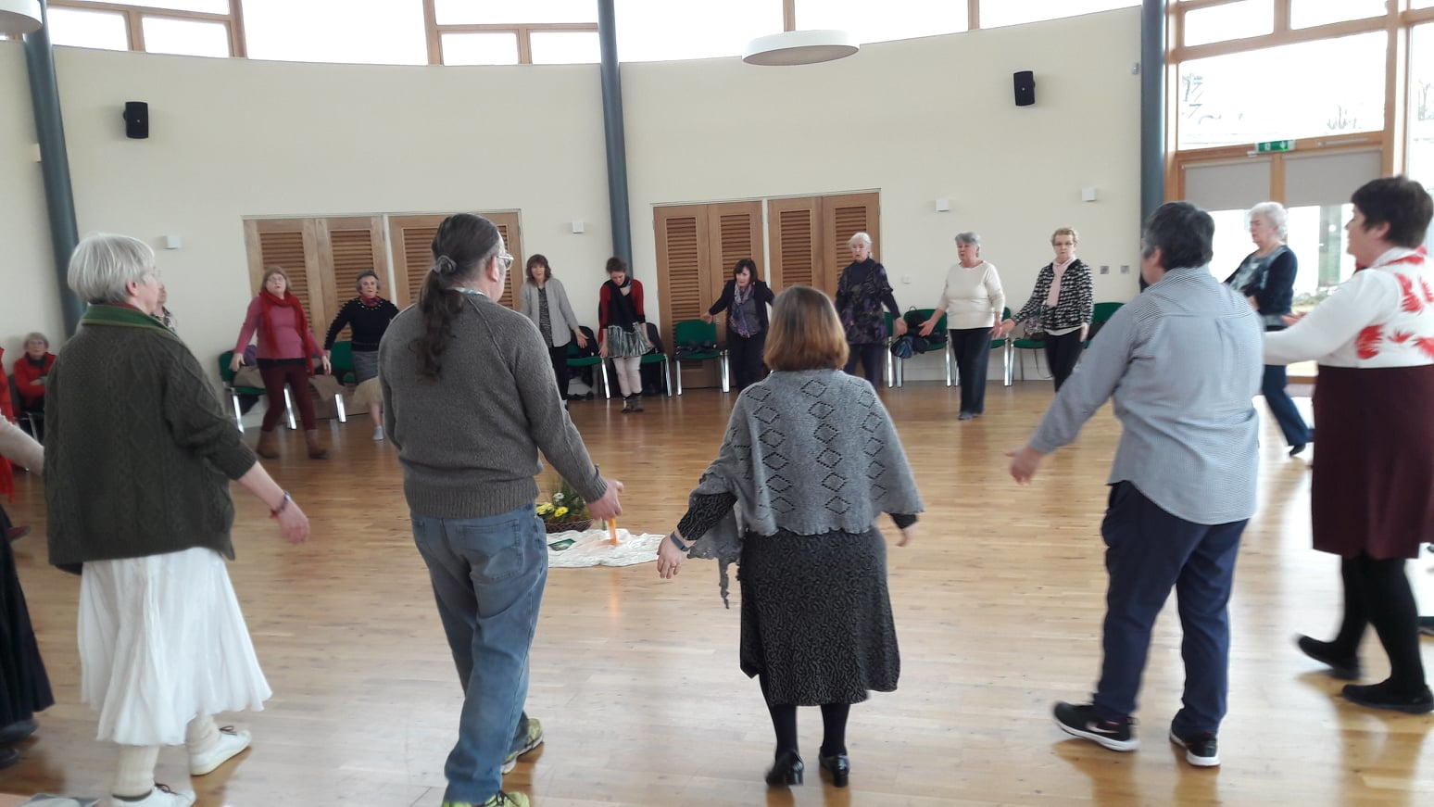

Slide 6
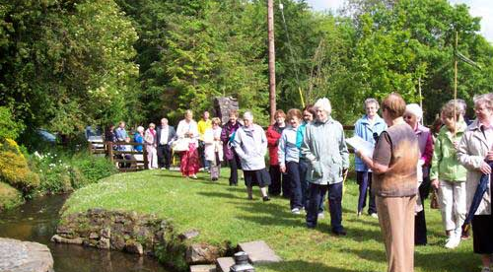

Slide 7
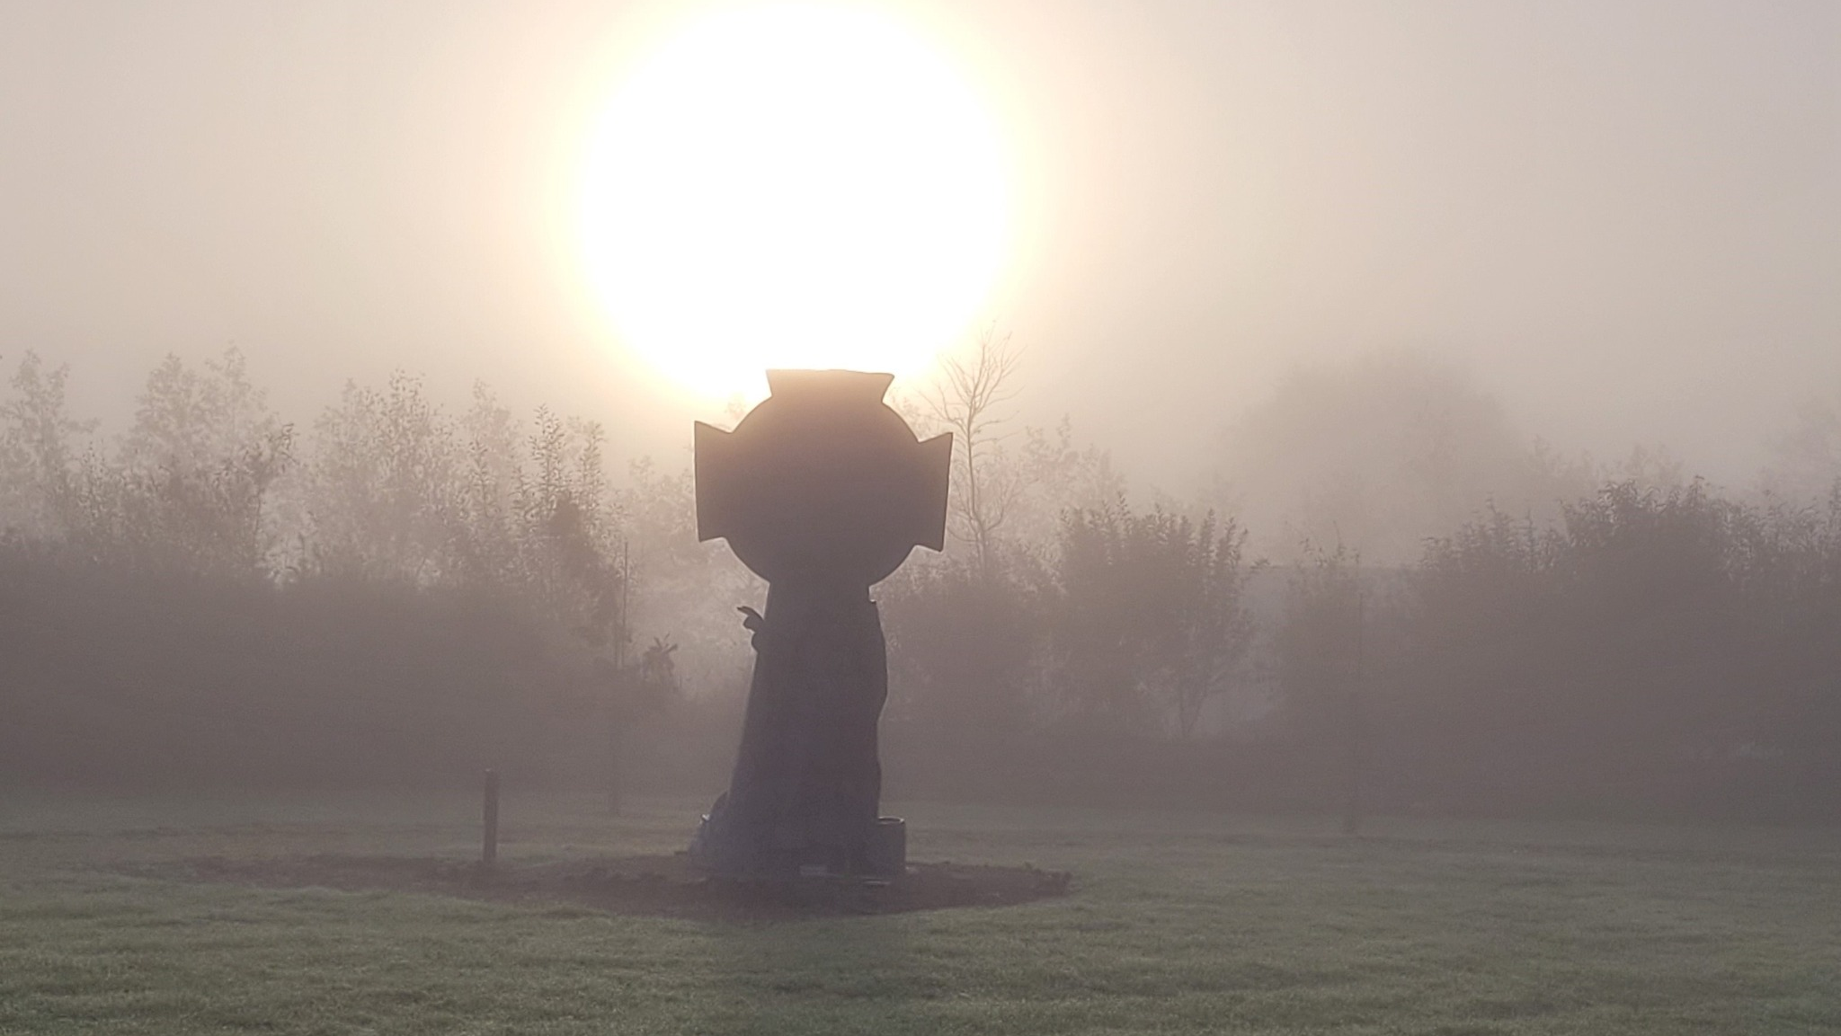

Slide 8
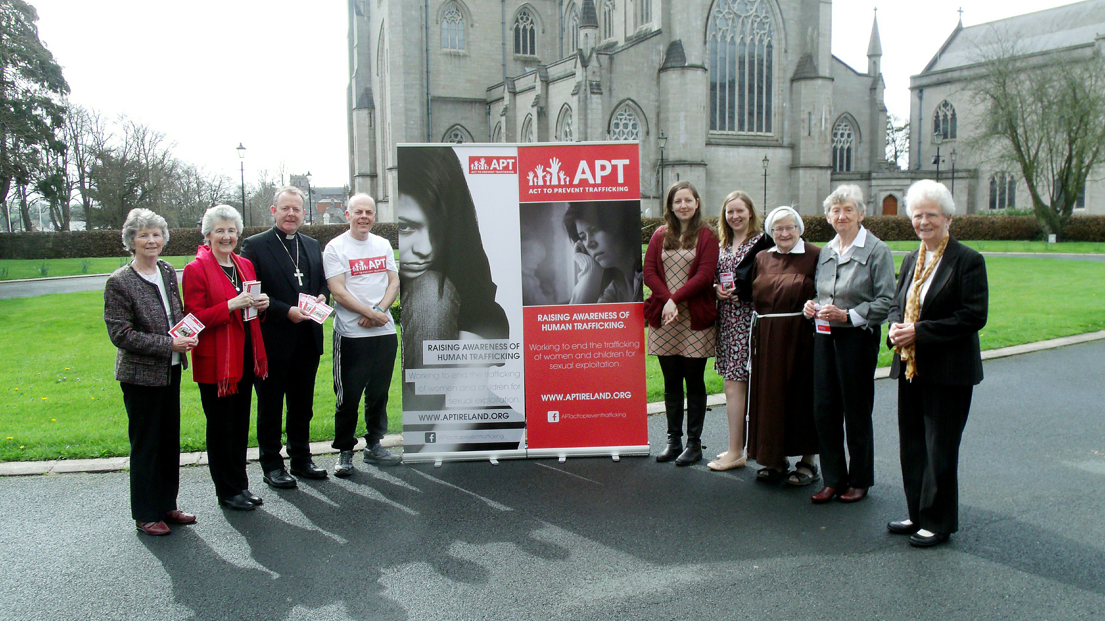

Slide 9
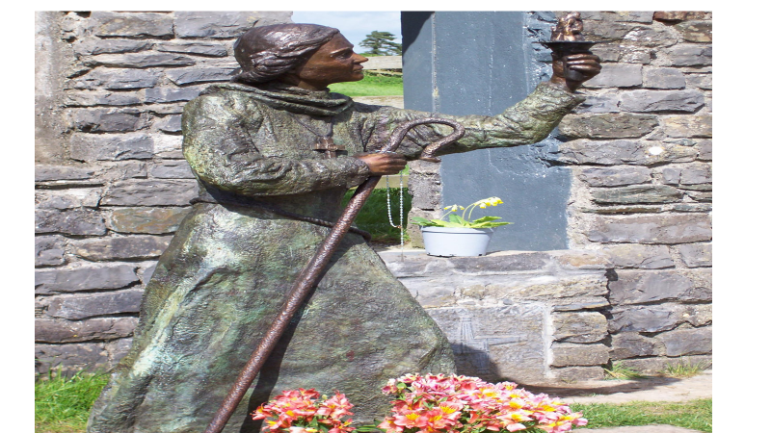

Slide 11
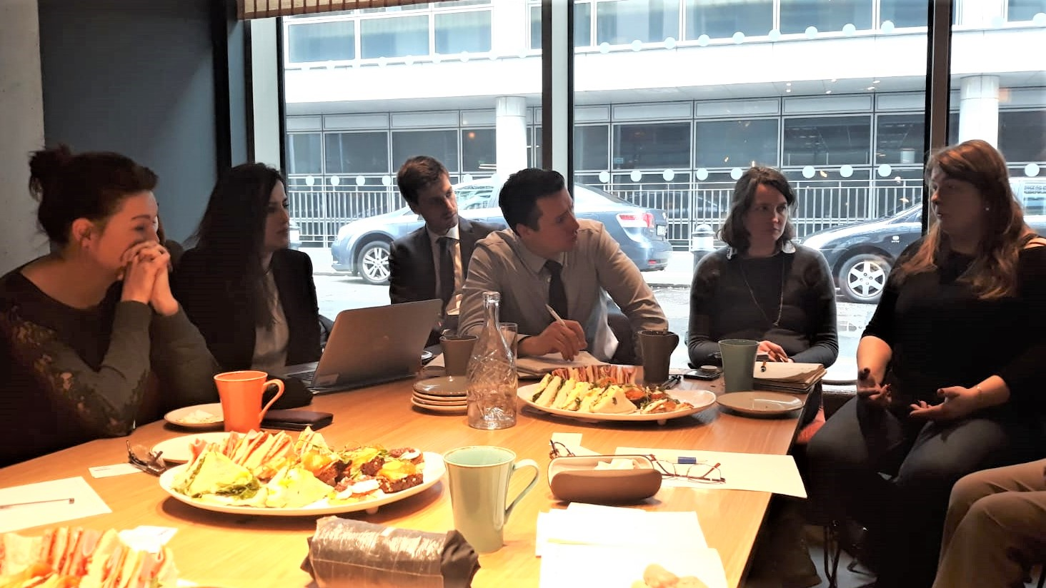

Slide 12
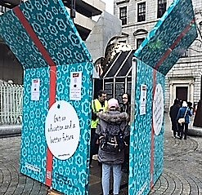

Slide 13
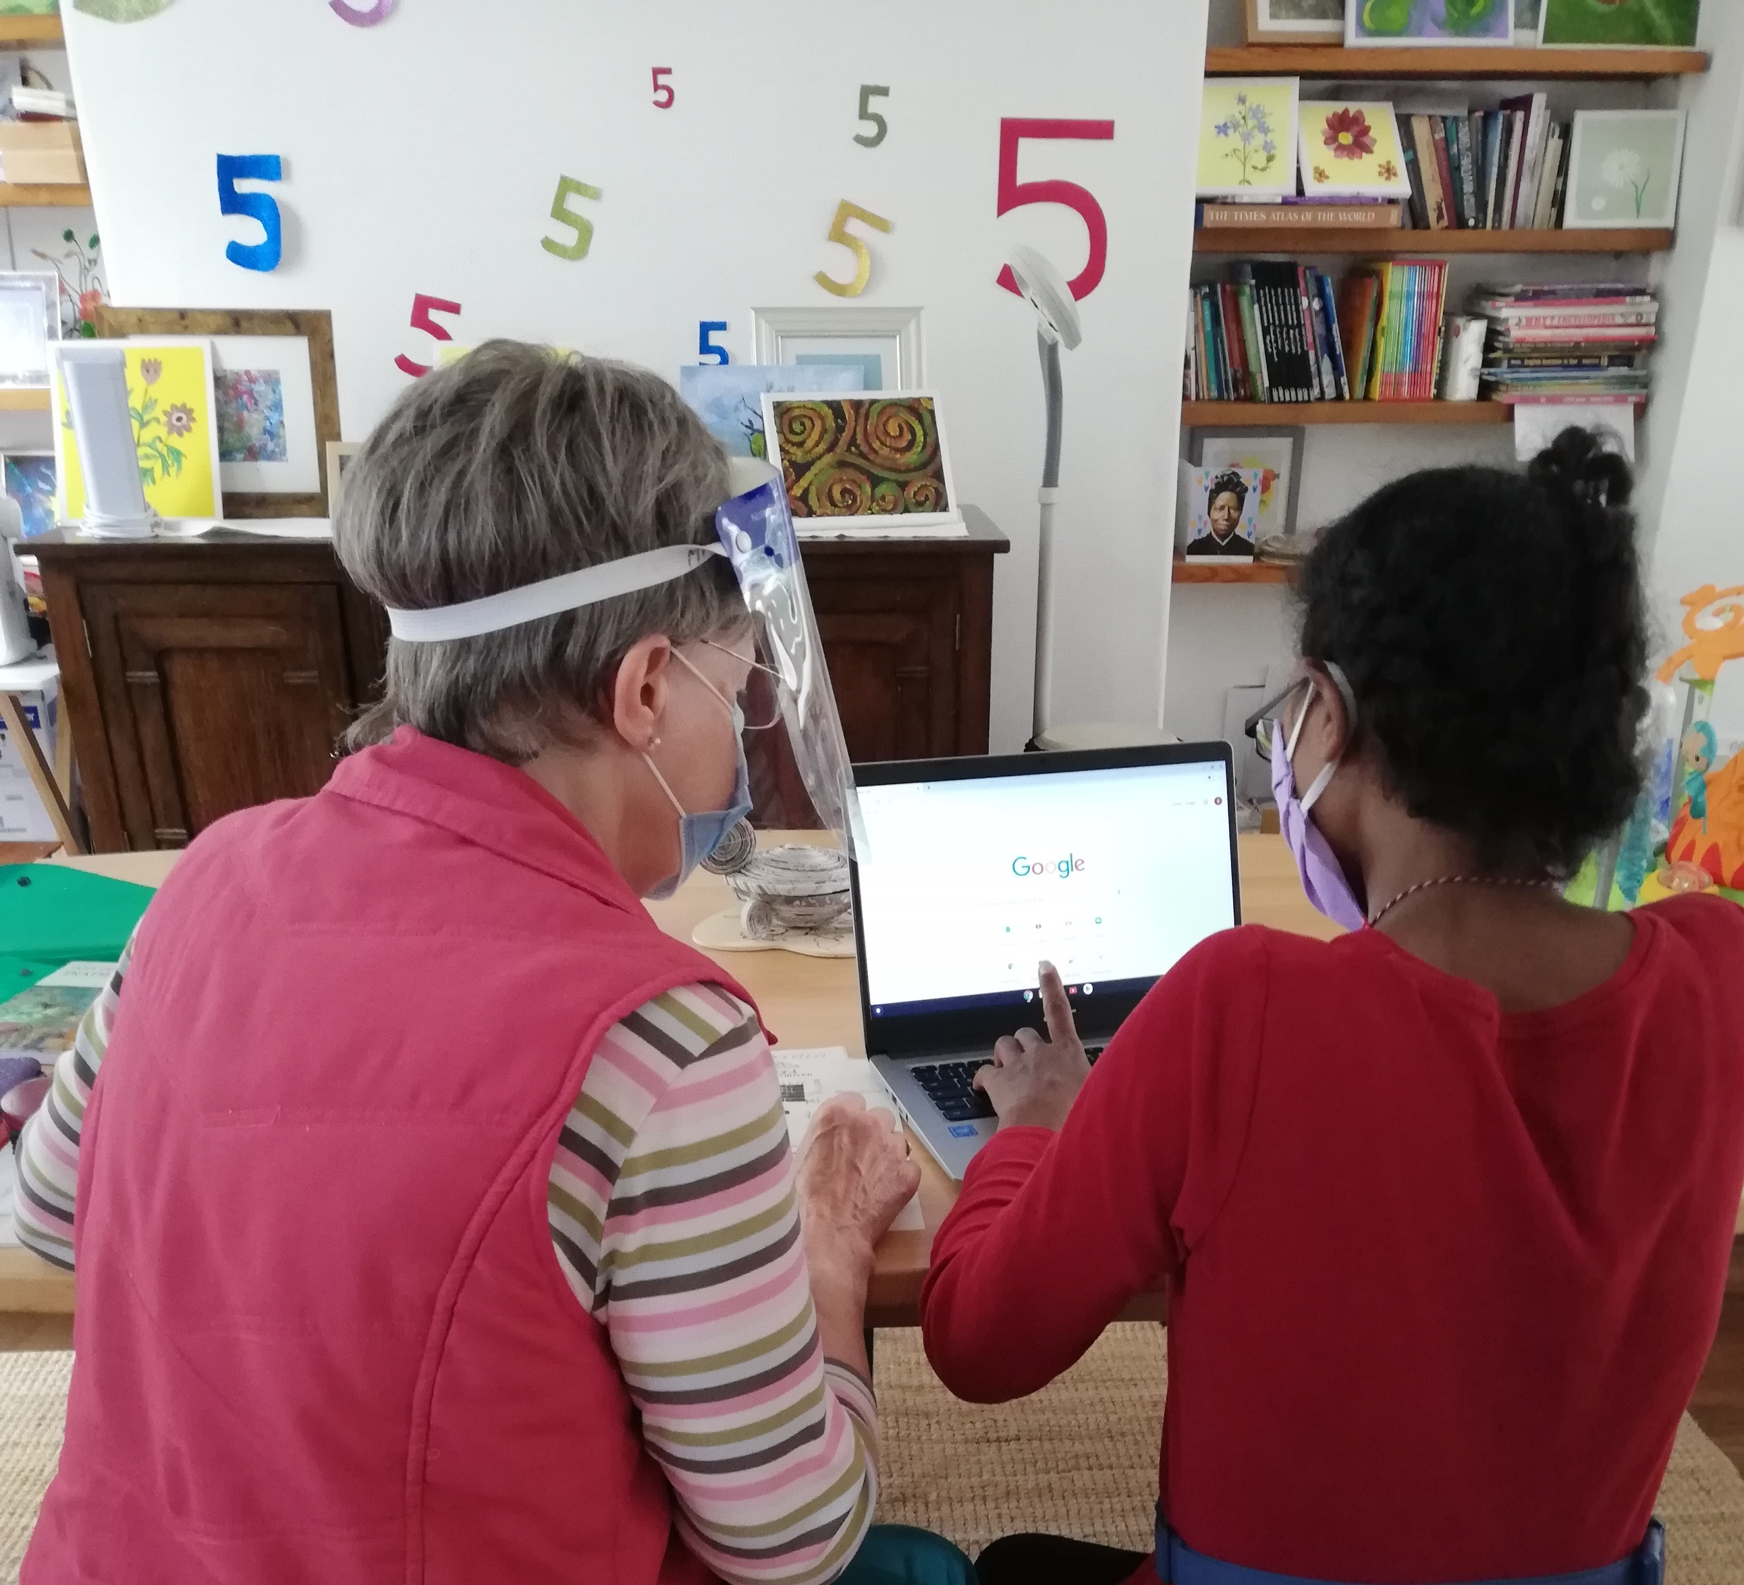

Slide 14
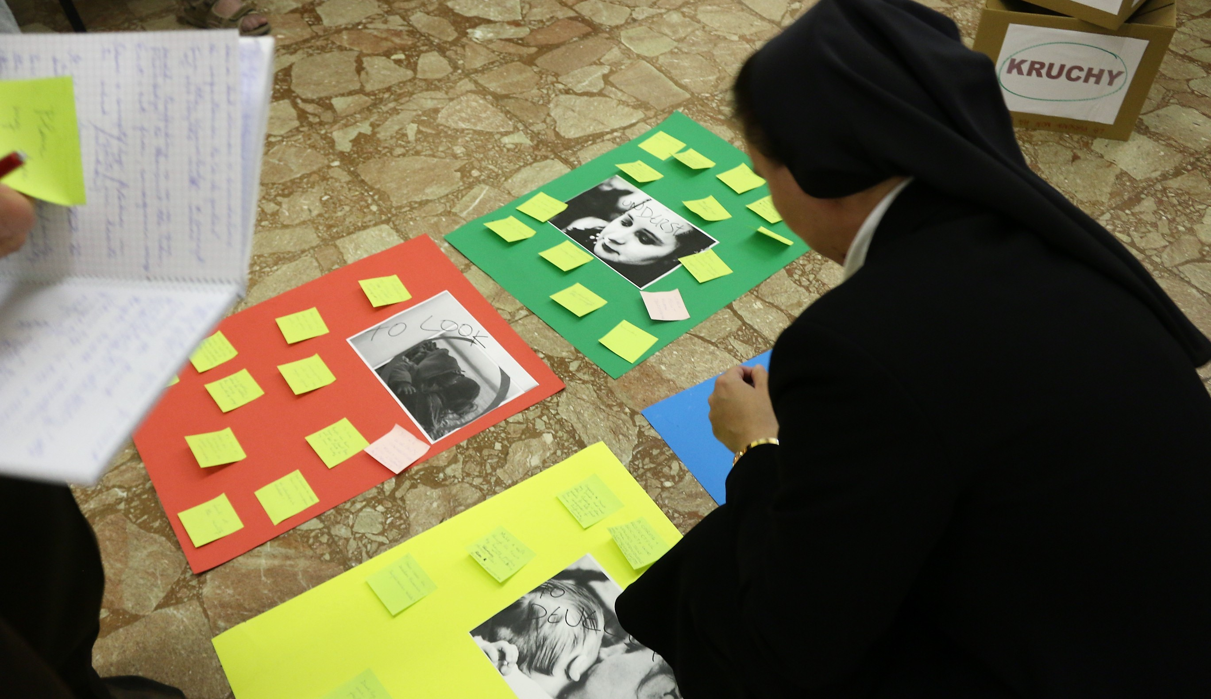

Slide 15
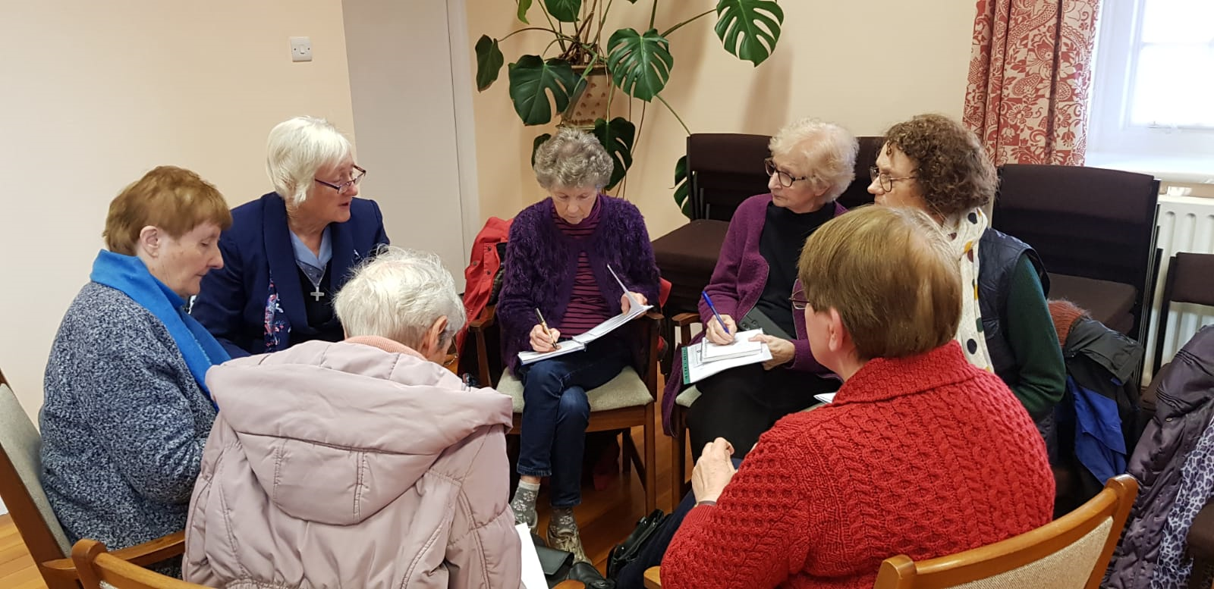

Slide 16
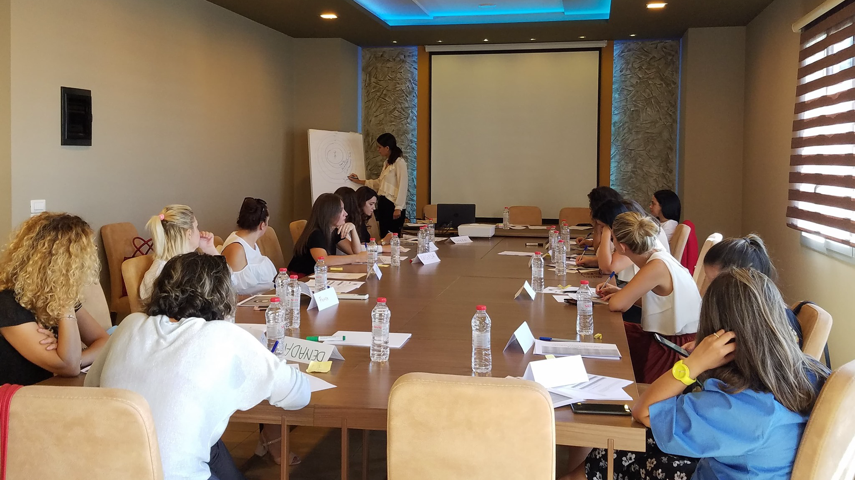

Slide 17
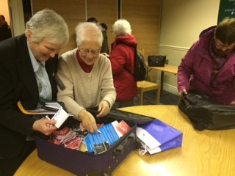
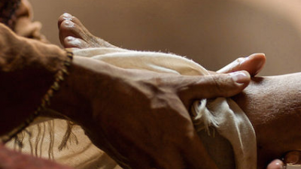

Slide 18
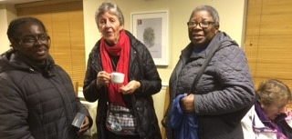

Slide 19
https://solasbhride.ie 00-353-45-544890
Tully Road, Brallistown Little, Kildare Town, Ireland.

