Slide 2
R E S E A R C H U N D E R T A K E N
USA - Polaris Project 2015 (2007- 2015)
92% victims were sexually exploited
94% females / 45% children
Hotels second most popular venue for sex trafficking
Europe - COMBAT Study 2016 (2014-2016)
> 93,000 victims of sex trafficking exploited in hotels, each year
Ireland - MECPATHS Research 2018
95% believe trafficking of children takes place in countries with lower incomes and high levels of poverty, not in Ireland.
90% of respondents were unaware of their responsibility to report any act of suspected harm against a child to the Gardaí, under Children First.

Slide 3
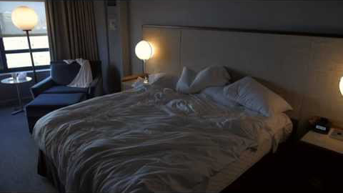
DOES YOUR HOTEL KNOW?
Source: ECPAT (Global network against child trafficking)

Slide 4
Hospitality Training Colleges
“We in the hospitality industry and related education sector therefore have a huge responsibility in raising awareness around this issue. Training our staff on what warning signs they can be looking out for and how we can all take steps to help counteract this growing worldwide problem. MECPATHS are currently doing some incredible work on this front and have been running very effective workshops with all our first year students here in Shannon over the past year.”
Shannon College of Hotel Management, A College of NUI Galway, Shannon, Co. Clare.

Slide 5
P O S S I B L E I N D I C A T O R S O F
S E X T R A F F I C K I N G W I T H I N H O T E L S
Exhibits fearful, anxious or submissive behaviour - lack of eye contact
Extended stay with few or no personal possessions
Dresses inappropriately given the weather and/or his/her age
Denies hotel staff entry into room on multiple successive days despite frequent visitors to the room
Excessive foot travel in/out of hotel room by non-registered guests at unusual hours
Large amounts of alcohol or presence of drugs in rooms where children are present
Presence of multiple computers, cell phones, pagers, credit card swipers, cameras, videos, or other technology
NOTE: These indicators MAY suggest that a person is a potential victim of trafficking. It is important to bear in mind that the presence of one of these signs does not necessarily indicate a case of sex trafficking, nor is this in anyway an exhaustive list of indicators. Staff should be vigilant of situations in which MULTIPLE indicators are present.

Slide 6
INDUSTRY CHAMPION

Slide 7
If you have been affected by
any of the issues in this presentation, you can contact:
The Samaritans @ 116 123
The Rape Crisis Centre @ 1800 77 88 88

Slide 8
M E C P A T H S . I E
#raiseyourvoice
I N F O @ M E C P A T H S . I E
@ M E C P A T H S

