Slide 1
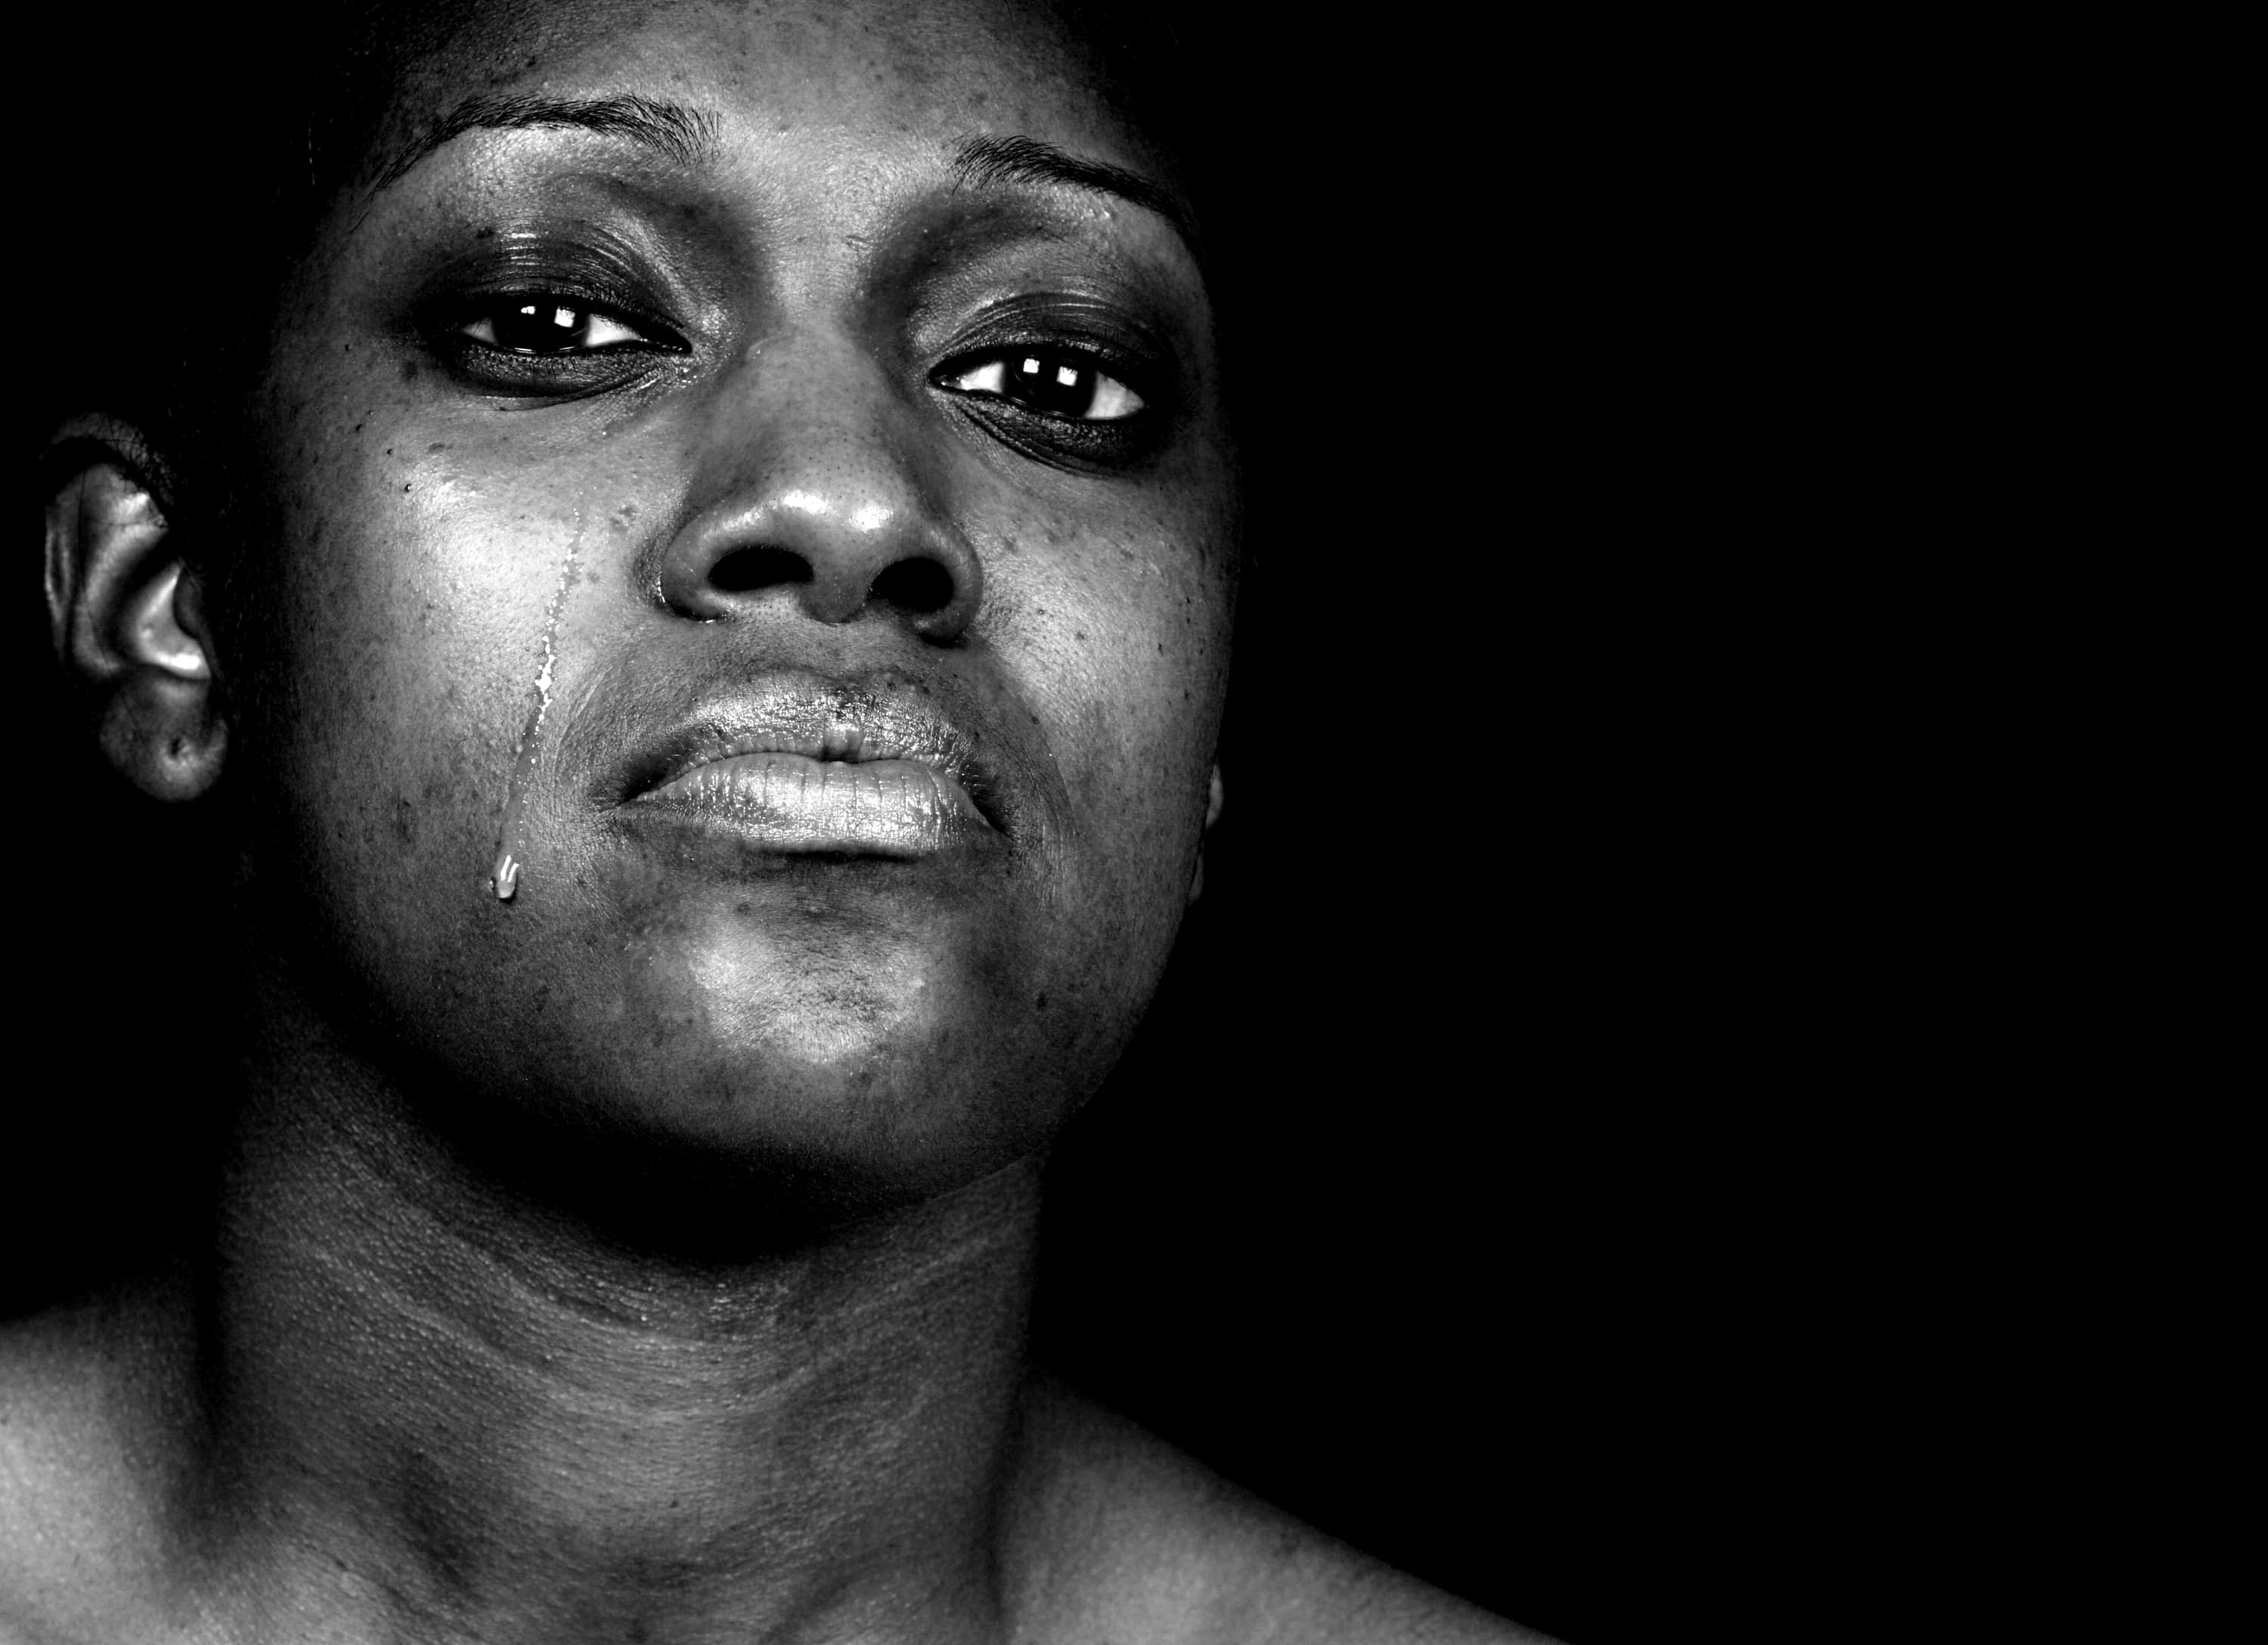
Human Trafficking for Sexual Exploitation
Hidden in Plain Sight
APT Conference 1st March 2019
Sheila Crowley - Ruhama

Slide 2
Introduction to Ruhama
Est: 1989
Personnel: 13 staff & 45 volunteers
Based in Dublin but works on a nationwide basis

Slide 3
Numbers
Ruhama has assisted over 3,000 women affected by prostitution from over 60 different countries
Assisted over 400 suspected victims of trafficking
Average 300+ clients per year (including Trans)

Slide 4
Profile of Women
Victims of sex trafficking
Street-based prostitution – mostly Irish/addiction, approx. 60 women per year
Indoor sex trade – escort/massage – mostly migrant, coming from low socio-economic backgrounds

Slide 5
Hidden in Plain Sight
In recent years the methods of traffickers have changed and some victims appear to have more freedom:
can come and go (tracking devices/phone)
Hold their own identification or papers
Get some money (send money home)
Get sexual health checks/medical checks
Living and working beside you

Slide 6
Hidden in Plain Sight
Coercion Vs actual violence
Threats against family
Grooming/vulnerability Vs abduction
Addiction as a form of control

Slide 7
Hidden in plain sight
Women may not ‘look like’ victims
They don’t identify as victims of trafficking (sometimes the most controlled - denies the most)
May already be in the asylum process – but if a trafficking lens is not used when looking at their story then it might be missed
How does she go from being a Vot (before 18) and an independent escort (after 18)?

Slide 8
Dictionary meaning of the noun ‘advertisement’
a paid announcement, as of goods for sale, in newspapers or magazines,on radio or television, etc.
a public notice, especially in print.
the action of making generally known; a callingto the attention of the public:The news of this event will receive wide advertisement.

Slide 9
Where does sexual exploitation take place? – is it underground?

Slide 10
Sex buyers buy sex from Victims of Trafficking
.

Slide 11
Ask Andreea?
https://youtu.be/9PmAxaWfXv4

Slide 12
Women’s needs
Multiple experiences of physical and sexual assaults/rapes – often resulting in injury
STIs including HIV
Addiction to numbing substances
Unwanted pregnancies
Low self-esteem and a low sense of self-worth
Anxiety and depression
Suicidal ideation and suicide attempts
Trauma as a result of constant sexual objectification, that affects all other aspects of their lives and relationships
Disassociation
Post-Traumatic Stress Disorder
Extreme isolation and exclusion: from friends, family, education, the workforce, society.

Slide 13
What we offer
Outreach services (street, HSE, Dochas)
Out-of-hours emergency response
Care planning and case management
Tailored casework support & advocacy
Short-term emergency accommodation
Education and Development Programme
Housing and Social Welfare Service
Counselling
Employment Programme
Collaboration with other agencies to ensure best outcome for VoT

Slide 14
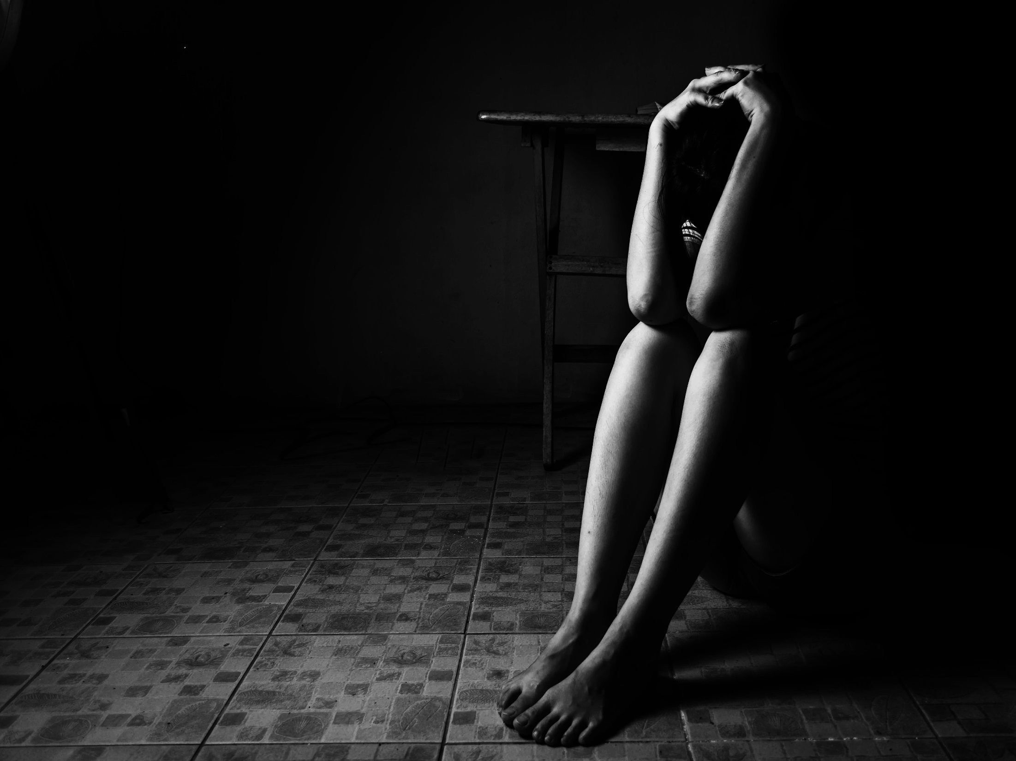
Dada
How to Contact Ruhama
Telephone:
Office hours: 9am-5pm (01) 836 0292
You will be put through to the Duty Caseworker
Out of office hours: 086 381 3783
Email: admin@Ruhama.ie
Free Text Reach: 50100
Thank You

