Slide 2
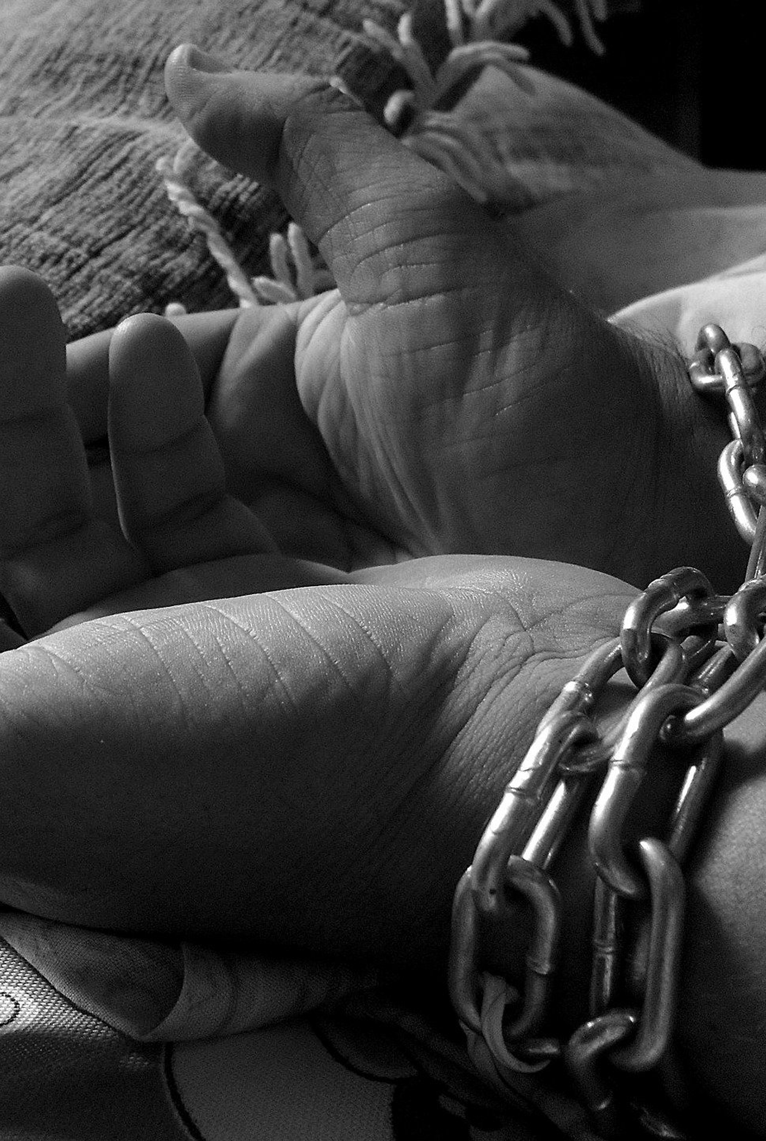
What is trafficking in persons?
The trade in, and exploitation of, human beings by criminals to make money.
Human Trafficking threatens women, men & children.

Slide 3
"Throughout our evolutionary story the universe constantly generates new life. Anything which degrades that life violates the sacredness of all life."
Prof. Mary Grey

Slide 4
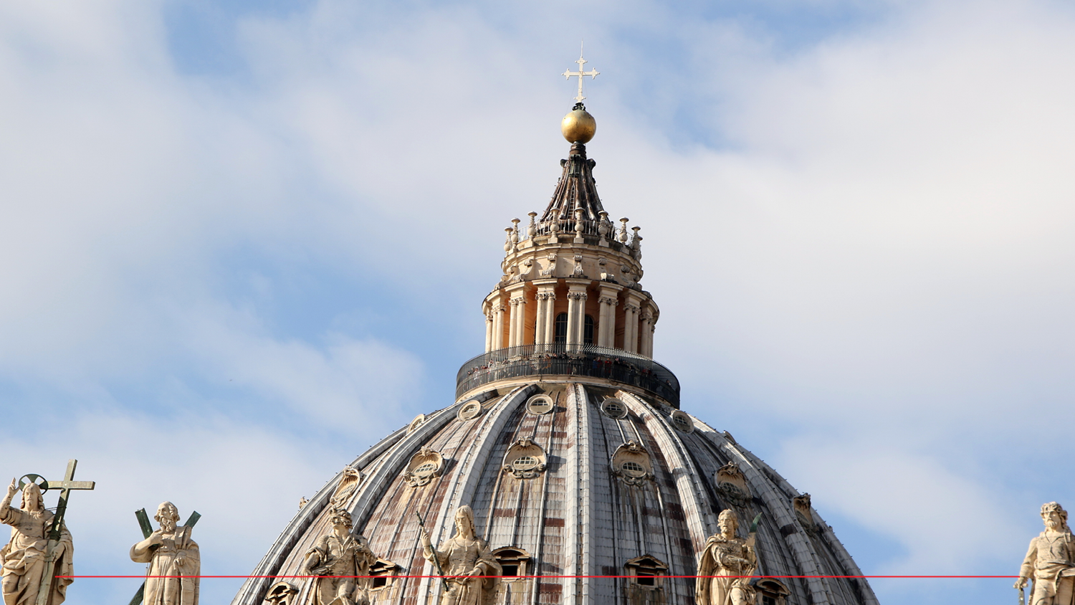
"Human trafficking is an open wound on the body of contemporary society,
a scourge upon the body of Christ. It is a crime against humanity.”
Pope Francis (2014)

Slide 5
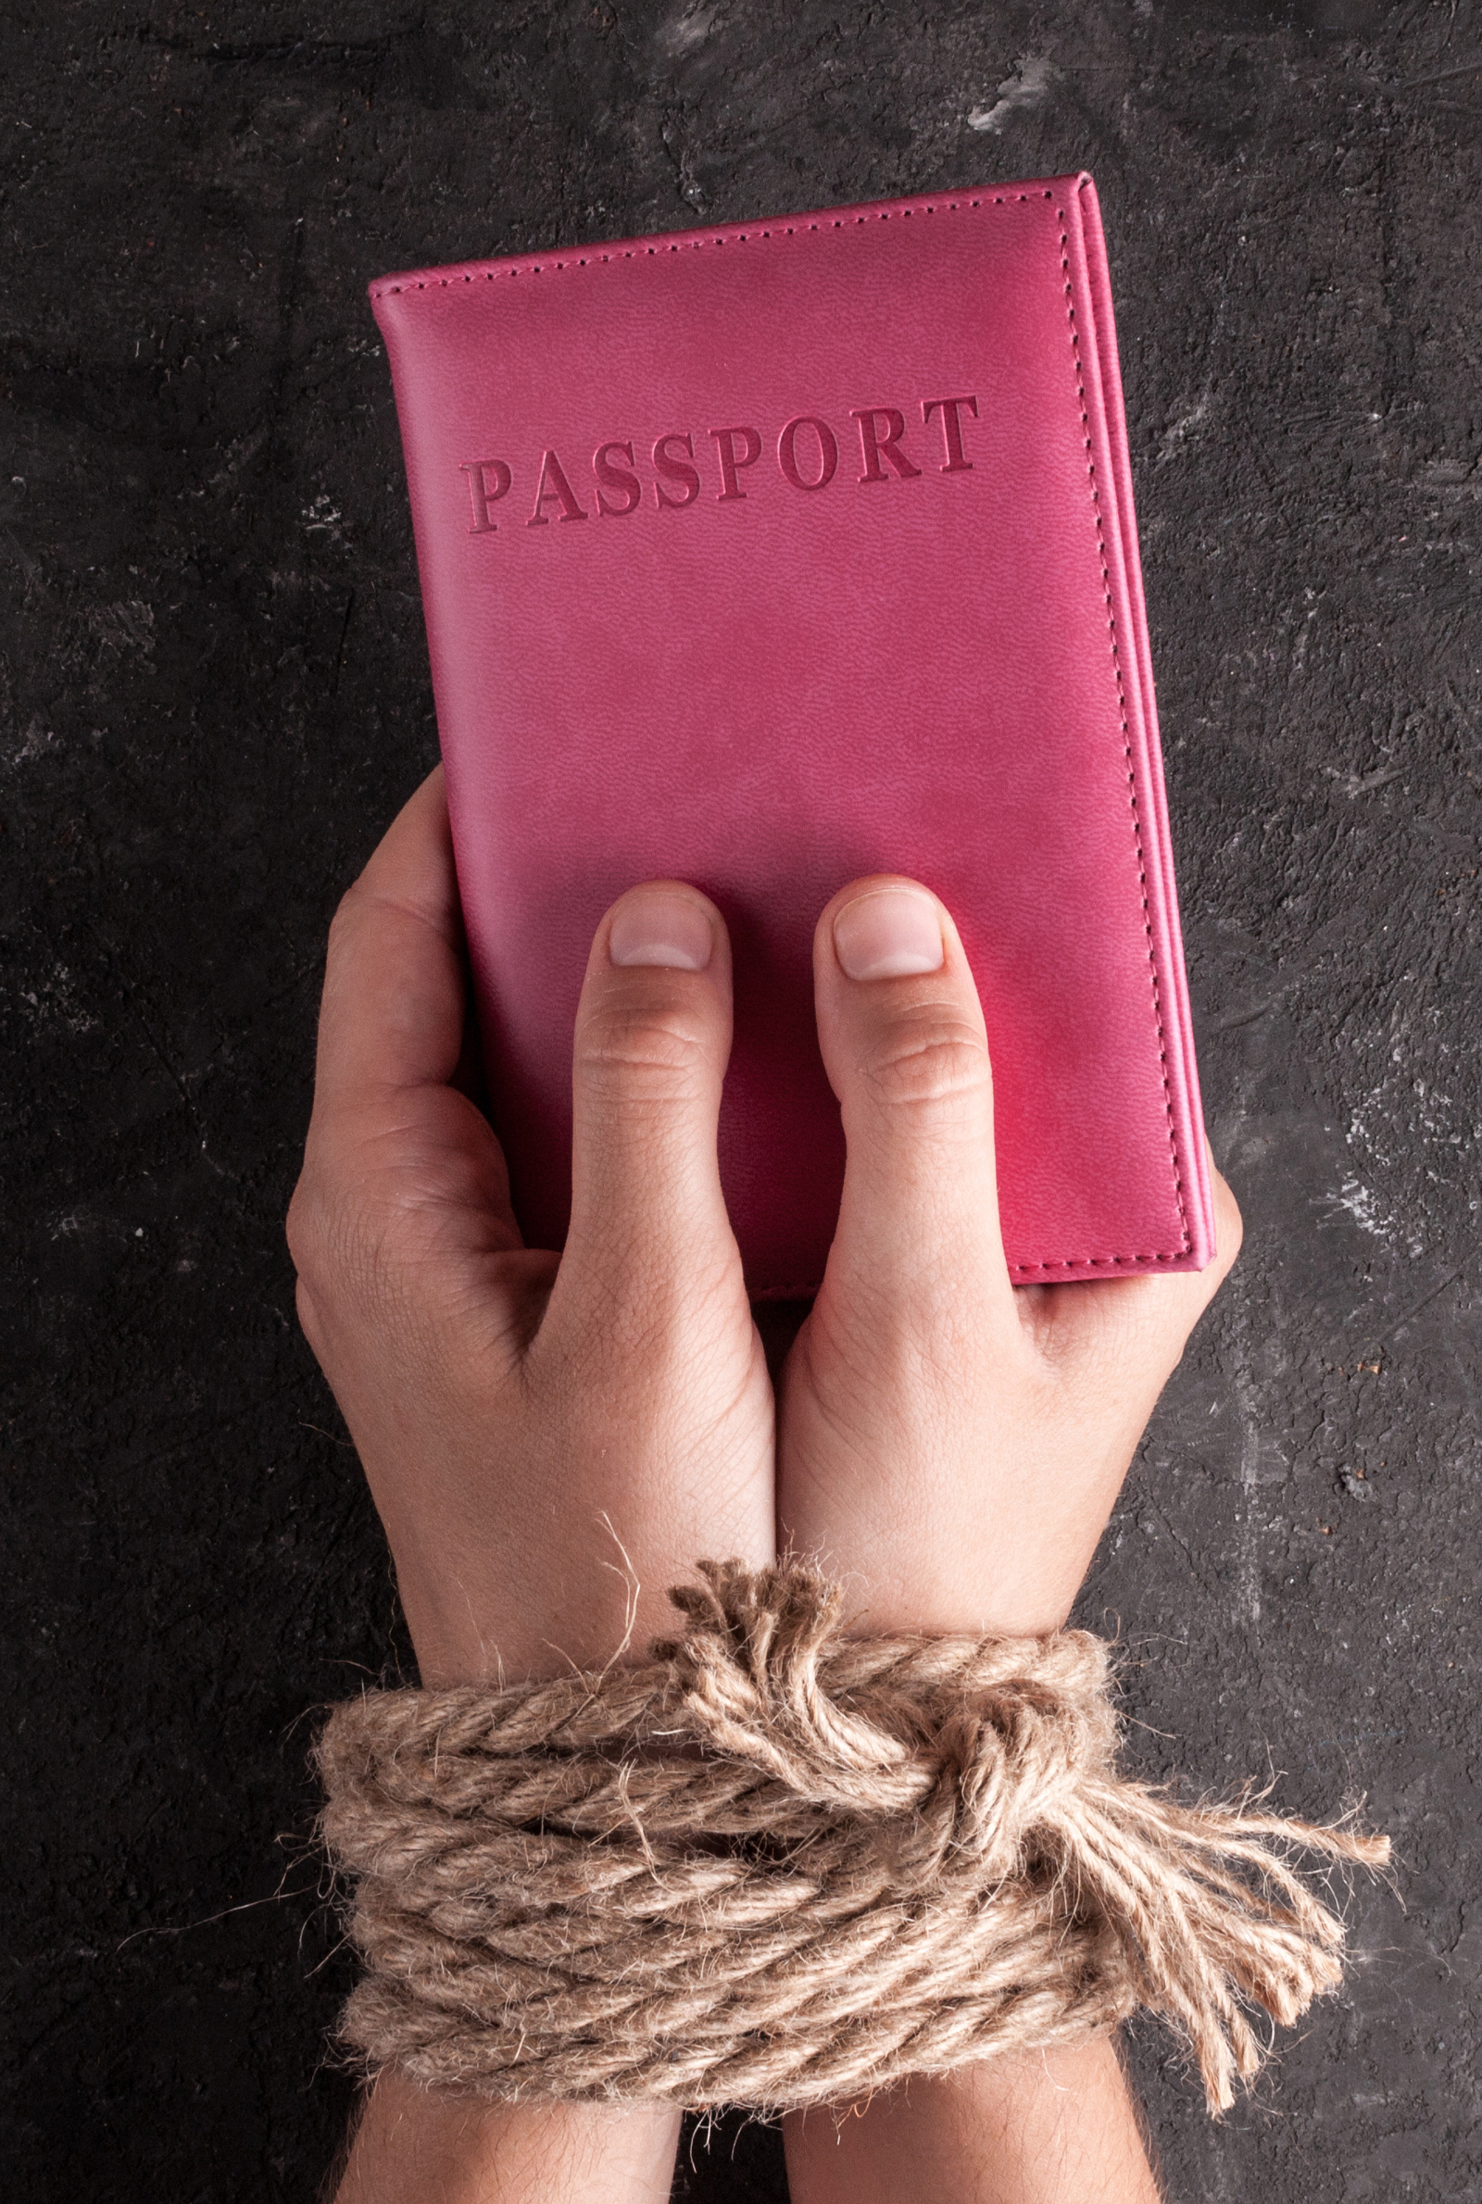
Different forms of human trafficking
Forced labour
Sale of human organs
Sexual exploitation
People are bought and sold as commodities

Slide 6
Smuggling vs Trafficking
Smuggling of migrants and human trafficking both involve moving human persons for profit
Smuggled persons are left to their own devices on arrival
Trafficked persons are under the control of others

Slide 7
Roots of trafficking
Push
Poverty
Inequality
Violence
Prior sexual exploitation
Lack of awareness about this crime
Pull
Job opportunities
Promise of freedom/independence
Chance of a better quality life
Demand

Slide 8
HUMAN TRAFFICKING
Poverty
GLOBALISATION
Weak Legislation
Gender attitudes
DEMAND
Denial
Pornography
Prostitution
Debts

Slide 9
Key Facts
Human Trafficking is one of the top 3 most profitable illegal trades
Fastest growing illegal trade.
20.9 million people per year globally – 4.5 million of these in sex trafficking.
$150 billion per year globally – $100 billion from sex trafficking.
Average annual profit per victim is $80,000.
Ireland has been identified as a source, transit and destination country for trafficking.

Slide 10
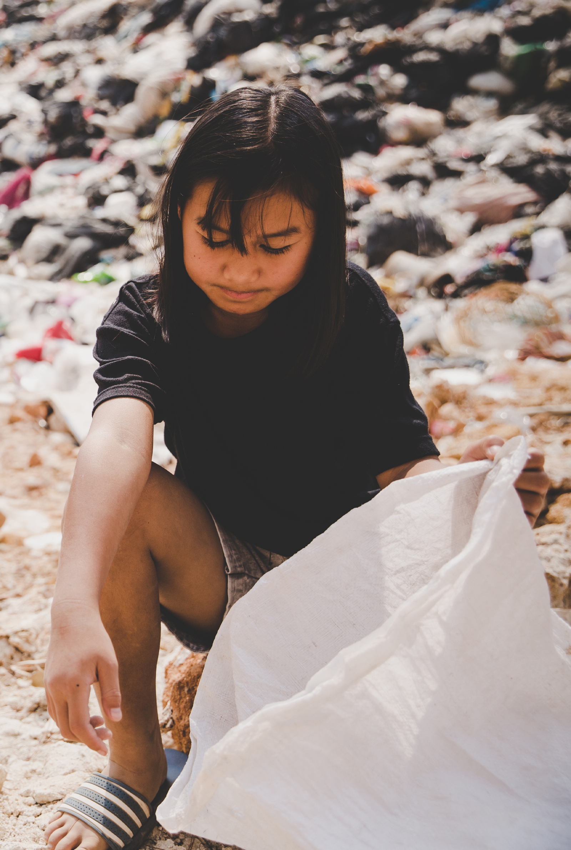
Who is trafficked?
Particularly vulnerable are:
Women and children.
People lacking money/opportunities.
People wishing to improve their lives, from all backgrounds, races, and classes.
Unskilled labourers.
Undocumented migrants.
Oppressed ethnic/cultural groups.

Slide 11
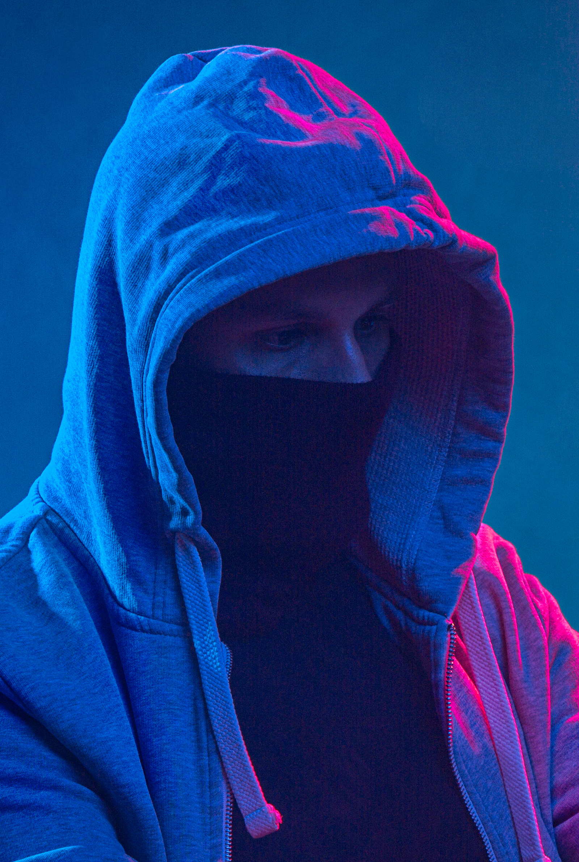
Who are the traffickers?
Traffickers can have many faces:
Male & Female.
Members of organised gangs.
Boyfriends.
Family & Friends.

Slide 12
How are people trafficked?
Traffickers recruit through:
Fake job ads: care work, modelling, dancing, hotel/bar work/study/travel.
Casual acquaintance/ “friends”.
Grooming – often online.

Slide 13
Extracts from profiles…
Julia aged 17, was given clothes and boots and a bag of condoms and told to do anything that clients wanted. Forced to have sex with a minimum of four men per night.
Kiky from Nigeria, was held in total captivity in a house in Ireland for two years.
Lydia from Poland, was chaperoned daily to a brothel in Italy and her movements were controlled. When she returned each day, her trafficker raped her in the apartment. She was subsequently brought to Ireland and forced into prostitution.

Slide 14
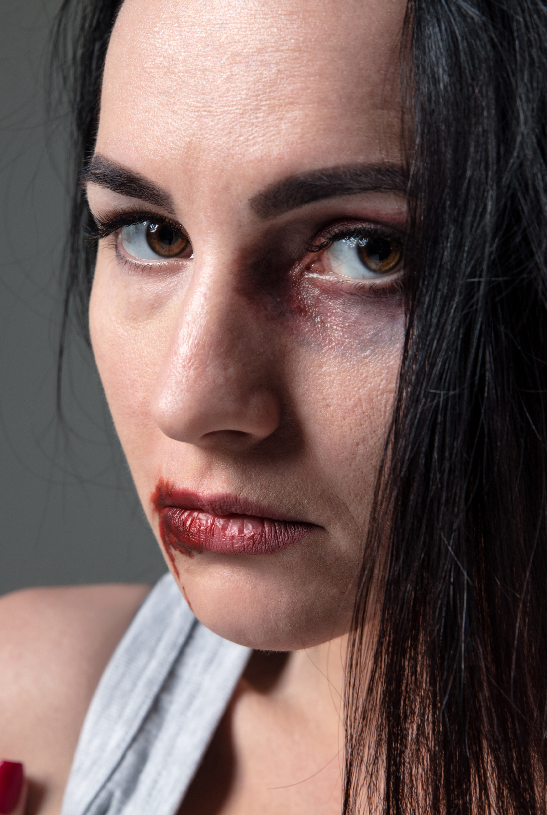
Why don’t trafficked persons escape?
Violence: Rape and beatings force them to comply
Threats/blackmail against their families back home.
Debt servitude: Held in bondage and responsible to trafficker.

Slide 15
Some statistics…
75% of all trafficking victims globally are women and girls
76% of victims in Europe are trafficked for sexual
exploitation (this figure is roughly the same for Ireland)
Up to 97% of women in indoor prostitution in Ireland are
migrant women
(3-13% are Irish)
There are at least 1,000 women (and girls) in indoor
prostitution at any one time in Ireland.

Slide 16
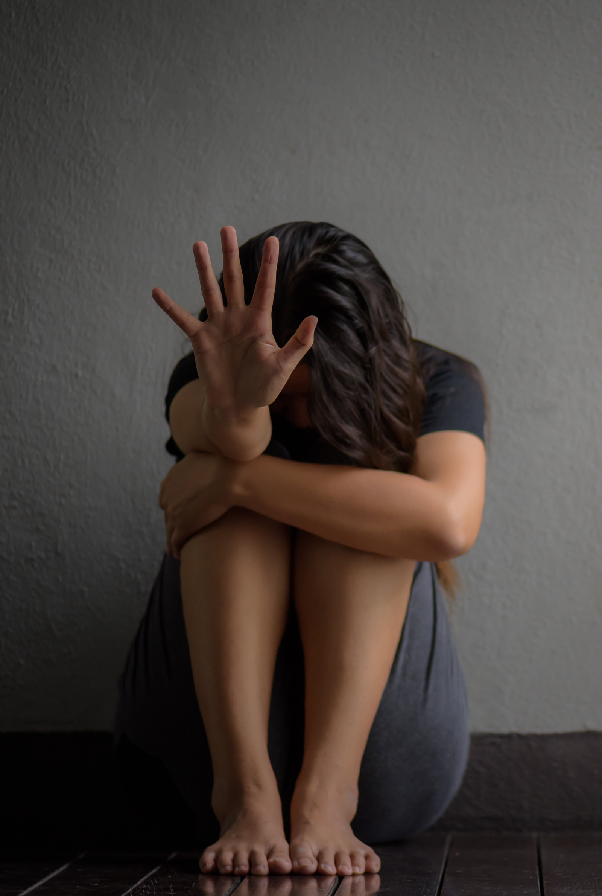
Effects on trafficked persons
Lack of trust/Anger/Fear
Insecurity/Confusion
Shame/Guilt
Depression/Helplessness
Post-traumatic stress disorder – e.g. flashbacks

Slide 17
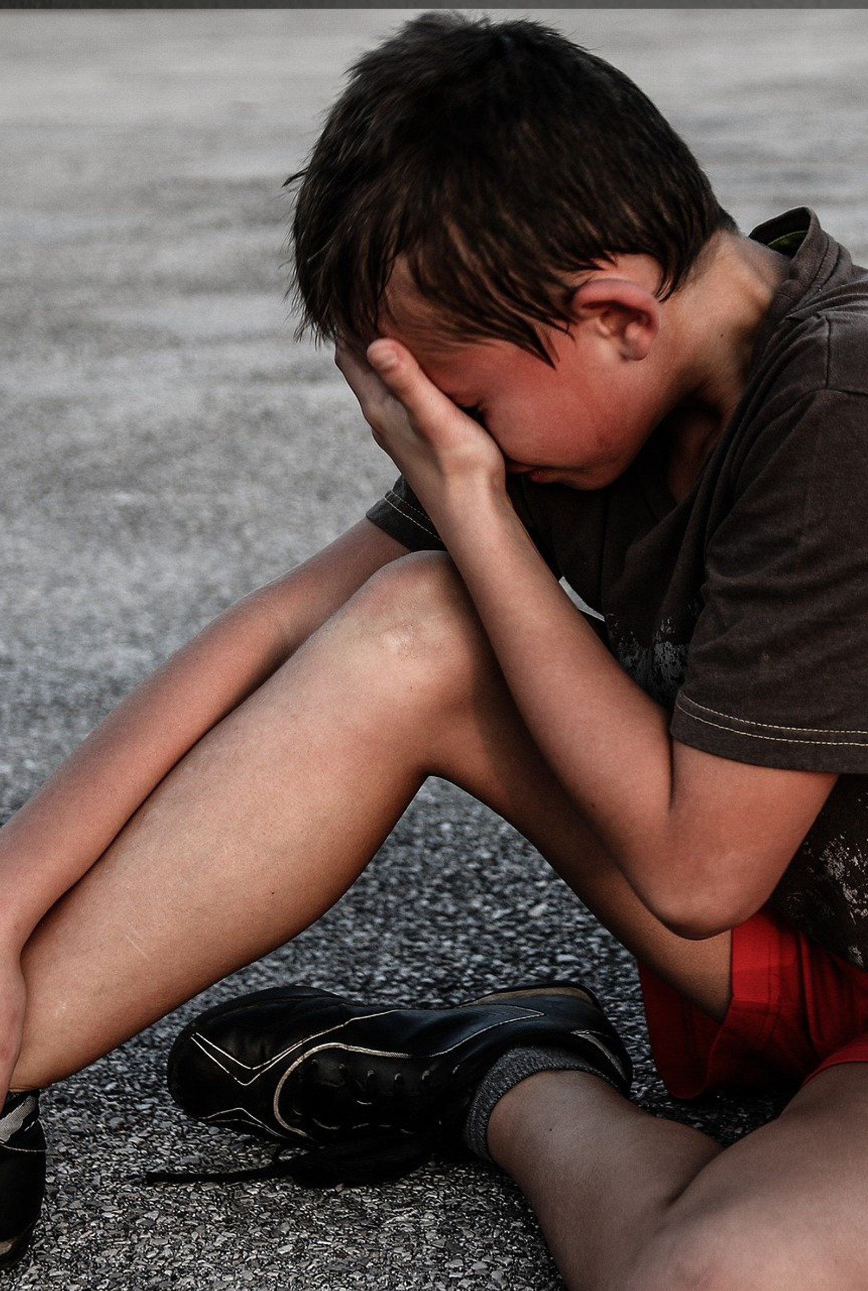
Why should we care?
Trafficking:
Is the most shocking form of human rights abuse and modern slavery.
It can happen anywhere, even in our own communities.
It could happen to someone you know.

Slide 18
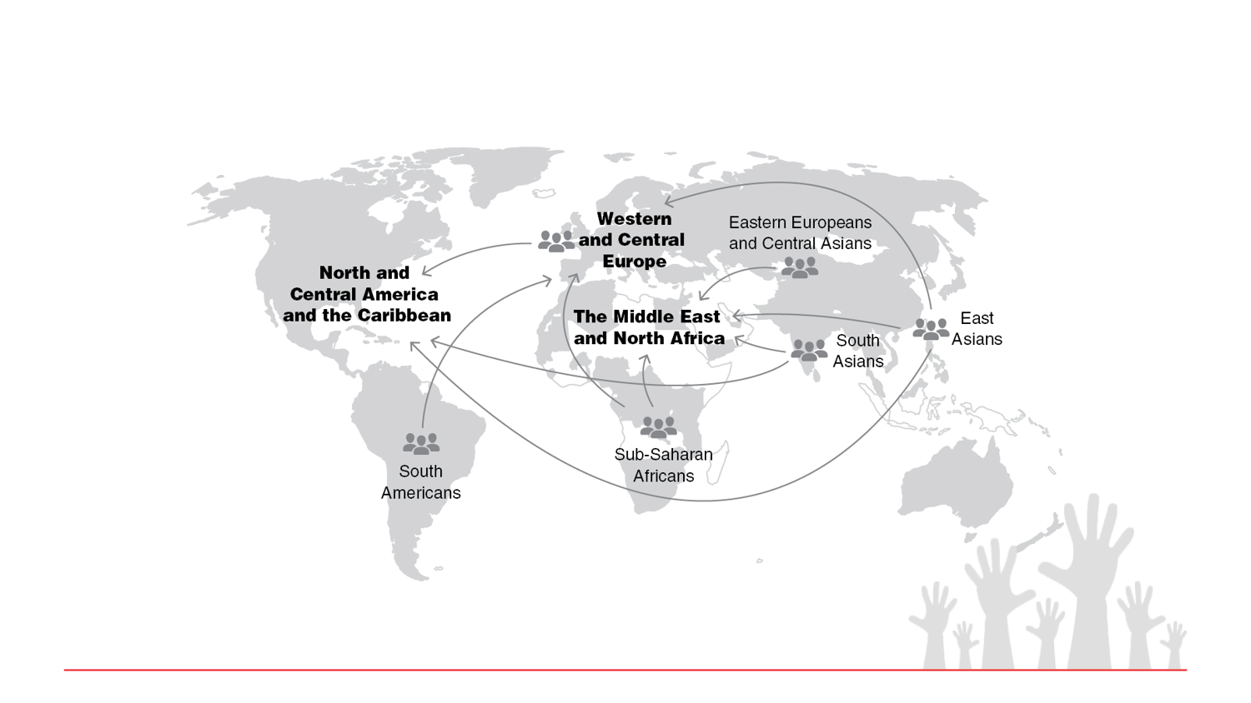
Trafficking Worldwide
Approximately 20.9 million per year

Slide 19
UN Palermo Protocol
(2000)
ACTION
‘the recruitment, transportation, transfer, harbouring or receipt of persons’
MEANS
‘threat or use of force or other forms of coercion, of abduction, of fraud, of deception, of the abuse of power, or of giving or receiving payments or benefits to achieve the consent of a person having control over another person’
PURPOSE
Exploitation –including prostitution or other forms of sexual exploitation

Slide 20
Council of Europe
Convention on Action Against Trafficking in Human Beings (2005)
A 'reflection period' of at least 30 days
Safe and secure housing
Psychological and emergency medical assistance
Information in a language the trafficked person can understand
Renewable residence permits to trafficked persons
Compensation for the abuses suffered

Slide 21
Ireland: Current legal stance
www.justice.ie
The Criminal Law (Human Trafficking) Act 2008:
PREVENT Trafficking
PROSECUTE Traffickers
PROTECT Victims
It is a criminal offence to solicit or importune, in any place, for the purpose of prostitution, a person whom one knows to have been trafficked.
The victim is allowed 60 days of recovery.
Administrative procedures in place for protection of victim.
Anti-Human Trafficking Unit (AHTU) of Dept. of Justice models best practice for protection of victim.

Slide 22
Sexual Offences Bill
(2014)
Criminalisation of the purchase of “sexual services” and decriminalisation of the selling of “sexual services” (the Nordic Model)
New criminal offences to protect children from grooming, including online, and to tackle child pornography

Slide 23
Trafficking in persons:
What can we do?
Become informed of human trafficking
Report any suspicious events, happenings in your local area to local police
Encourage people to talk to each other about this modern day slavery
Promote non-violence in all situations
Respect the dignity of each person
Organise a speaker to your relevant groups
Promote fair trade and check retailers supply chain

Slide 25
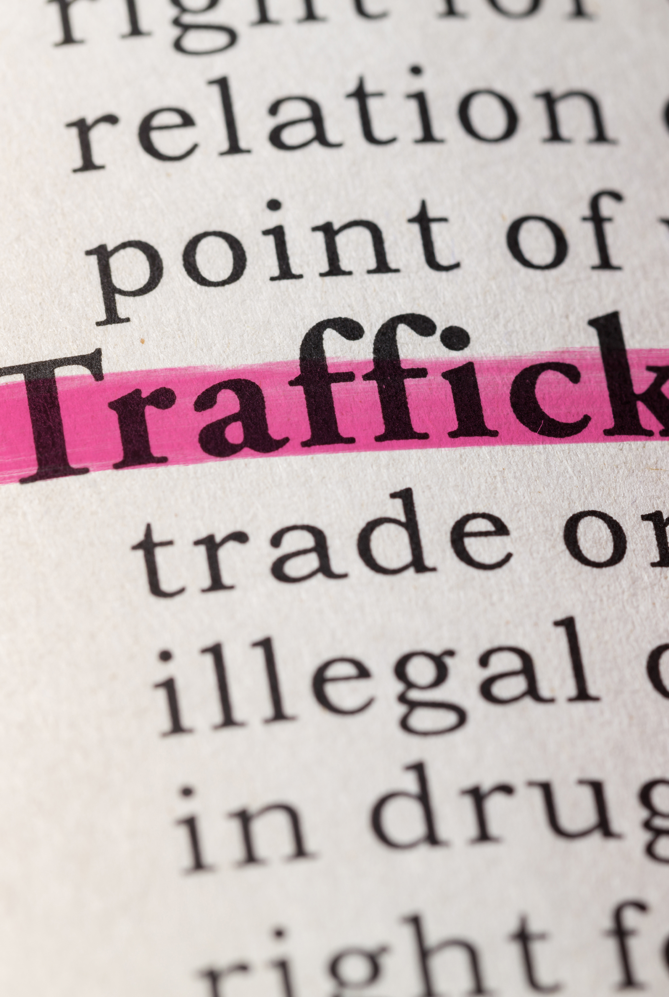
Trafficking in persons:
What can we do?
Become informed of human trafficking
Report any suspicious events, happenings in your local area to local police
Encourage people to talk to each other about this modern day slavery
Promote non-violence in all situations
Respect the dignity of each person
Organise a speaker to your relevant groups
Promote fair trade and check retailers supply chain

Slide 26
List of Resources
Websites
www.aptireland.org
www.ruhama.ie
www.blueblindfold.ie
www.immigrantcouncil.ie
www.turnofftheredlight.ie
www.tirzah.ie
International Organisations
COATNET - Christian Organisations Against Trafficking in Human Beings
Anti Slavery International
Global Alliance Against Traffic in Women (GAATW)
The Coalition Against Trafficking in Women (CATW) International
Religious in Europe Networking Against Trafficking and Exploitation

Slide 28
Reflection
By Lucy Berry
Dear God
No one is owned except by you
Who made us, loves us, owns us too.
And no one is made less than pure
By what the world makes them endure.
And no one is loved less by you
Through what they have been forced to do.
For no one is no one to you.
What ever life has brought them to.
And when they’re freed to run to you,
They’ll know, no one’s no one to you.

Slide 29
“I exhort the international community to adopt an even more unanimous and effective strategy against human trafficking, so that in every part of the world, men and women may no longer be used as a means to an end, and that their inviolable dignity may always be respected.”
Pope Francis, 10th April 2014, Rome
Addressing an international conference in Rome on the issue of human trafficking.
Pope Francis is calling for people to see anti human trafficking efforts as prophetic ministry.

Slide 30
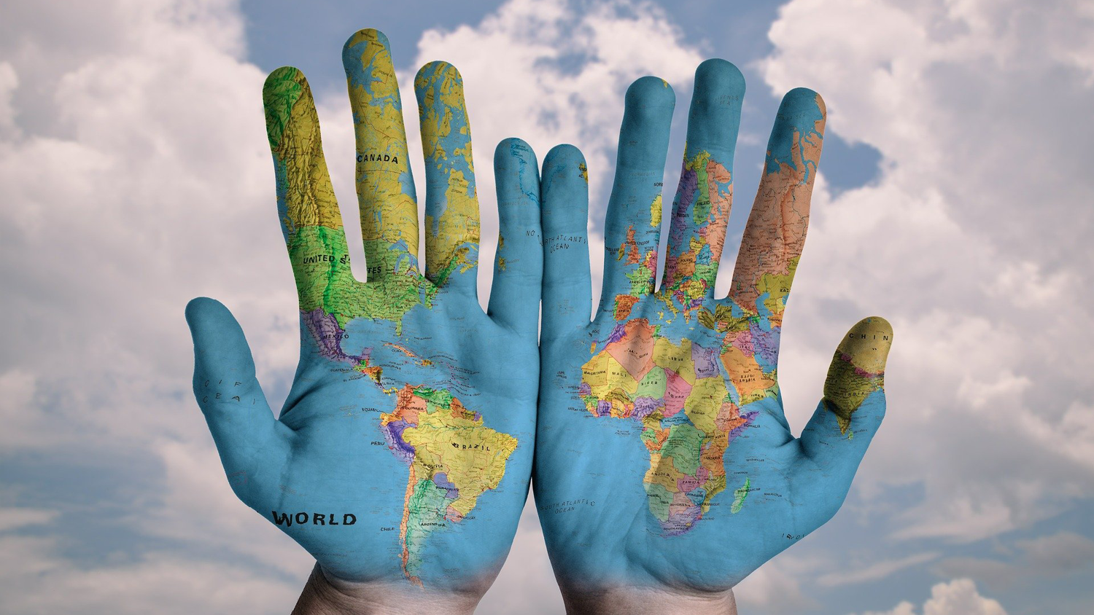
“I have come that they might have life and have it to the full…”
Jn 10:10

